Slide 1

Blockchain Applications for Supply Chain Transparency in Conservation
Information Security Fundamentals | Ecological Behaviour and Knowledge Management
Course: Information Security Fundamentals | Chapter: Ecological Behaviour and Knowledge Management | Program: Bachelor of Engineering
DISCOVER · LEARN · EMPOWER
Notes:
Welcome everyone to this lecture on Information Security Fundamentals. Today we explore how blockchain technology transforms supply chain transparency within the context of ecological behaviour. This session is designed to empower you with the knowledge to secure environmental data. Let us begin our journey of discovery and learning.

Slide 2
Course Outcomes
SLIDE 2 / 14
Course Outcome
CO | BT LEVEL | DESCRIPTION
CO1 | BT4 | Recall, analyze and respond on fundamental environmental principles, such as ecological relationships and conservation strategies
CO2 | BT4 | Understand and analyze the interconnections between human activities and environmental impacts across different ecosystems
CO3 | BT4 | Understand and analyze and apply environmental laws and policies to analyse and propose solutions for real-world environmental challenges.
CO4 | BT2 | Students will analyse data from environmental monitoring programs to assess trends and predict future impacts on ecosystems.
CO5 | BT6 | Interpret, elaborate and propose various tools, design and innovative strategies for sustainable development and environmental conservation initiatives in securing the planet.
Chandigarh University
2 / 14
Notes:
This lecture directly addresses Course Outcome 4, which focuses on data analysis for environmental monitoring. By understanding blockchain, you learn how to verify the integrity of data used to assess ecosystem trends. This ensures that the data we analyze is trustworthy and not tampered with by bad actors. We will see how this leads to better predictions of future environmental impacts.

Slide 3
Learning Objectives
SLIDE 3 / 14
Learning Outcomes
1
Define blockchain technology and its core components for conservation applications.
2
Explain how distributed ledgers ensure supply chain transparency in ecological monitoring.
3
Identify key benefits of immutable records for tracking endangered species and resources.
4
Analyze a numerical example of data verification time reduction using blockchain.
5
Recognize common implementation pitfalls in environmental data management systems.
Chandigarh University
3 / 14
Notes:
By the end of this session, you will be able to define blockchain and its specific role in conservation. You will understand how distributed ledgers create transparency where it is needed most. We will also work through a numerical example to see the efficiency gains. Finally, we will discuss the pitfalls to avoid when implementing these systems.

Slide 4
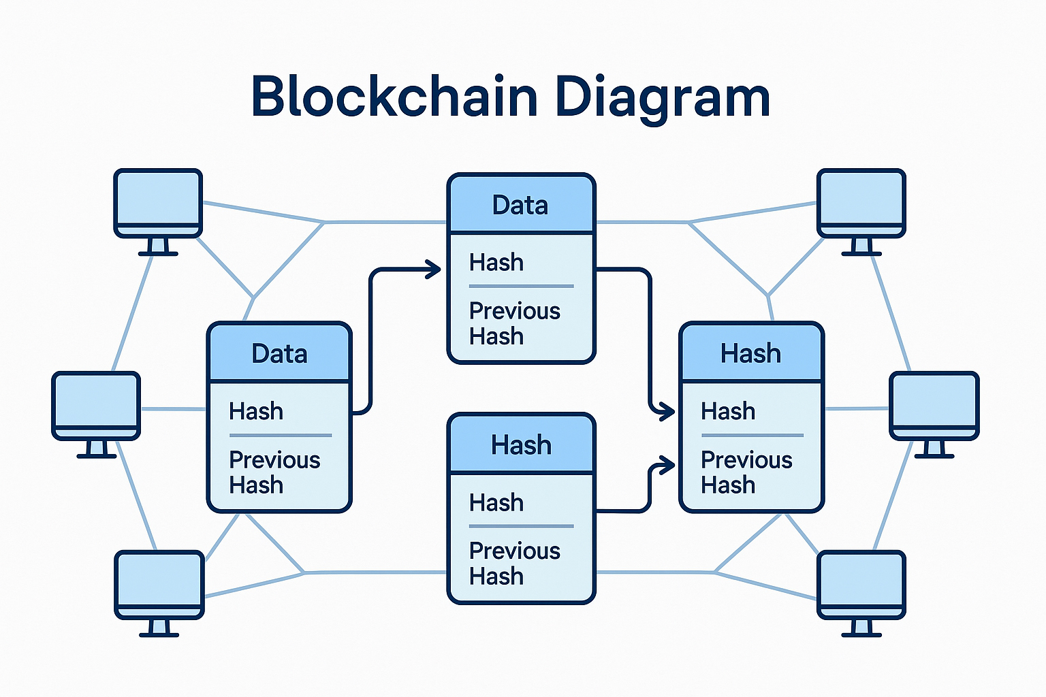
Lecture
SLIDE 4 / 14
Blockchain Definition for Conservation
1
Blockchain is a decentralized digital ledger recording transactions across many computers.
2
Each block contains a cryptographic hash linking it to the previous block.
3
Data immutability ensures environmental records cannot be altered after verification.
4
Transparency allows all stakeholders to view the same verified ecological data.
5
Consensus mechanisms validate new entries without a central controlling authority.
Bitcoinwiki
Chandigarh University
4 / 14
Notes:
Think of blockchain as a shared notebook where every page is locked and linked to the previous one. Once a page is written, no one can erase or change it without breaking the chain. In conservation, this means a record of a poaching incident or a species count cannot be faked later. This immutability is the foundation of trust in our ecological data.

Slide 5
Lecture
SLIDE 5 / 14
Supply Chain Transparency Mechanism
1
Smart contracts automatically execute rules when environmental conditions are met.
2
IoT sensors feed real-time data directly into the blockchain ledger.
3
Every step from source to consumer is recorded with a unique digital ID.
4
Stakeholders verify product origin without needing to trust a single intermediary.
5
Tamper-proof logs prevent illegal logging or fishing from being hidden.
Chandigarh University
5 / 14
Notes:
In a supply chain, we use IoT sensors to capture data like temperature or location automatically. This data is immediately hashed and added to the blockchain, creating an unbreakable trail. For example, a shipment of timber gets a digital ID that tracks its journey from the forest to the factory. If the data is tampered with, the chain breaks, and the system alerts us immediately.

Slide 6
Lecture
SLIDE 6 / 14
Ecological Data Integrity Benefits
1
Immutable records prevent falsification of endangered species population counts.
2
Traceability ensures sustainable sourcing of materials like palm oil or timber.
3
Public trust increases when conservation data is verified by independent nodes.
4
Regulatory compliance is automated through smart contracts for environmental laws.
5
Historical data remains accurate for long-term trend analysis and research.
Chandigarh University
6 / 14
Notes:
The primary benefit here is data integrity. When we track endangered species, we cannot afford for someone to lie about the numbers. Blockchain ensures that once a count is recorded, it stays that way forever. This builds public trust because anyone can verify the data independently. It also automates compliance, ensuring that environmental laws are followed without manual oversight.

Slide 7
Worked Numerical Example
SLIDE 7 / 14
Verification Time
GOVERNING EQUATION
Traditional verification time (T_trad) = 50 hours for a full supply chain audit
RESULT
96% reduction in time required to verify ecological data integrity.
• Blockchain verification time (T_block) = 2 hours due to automated consensus.
• Time saved (ΔT) = T_trad − T_block = 50 − 2 = 48 hours.
• Efficiency gain percentage = (ΔT / T_trad) × 100 = (48 / 50) × 100%.
Chandigarh University
7 / 14
Notes:
Let's look at a concrete example. A traditional audit of a timber supply chain might take 50 hours of manual checking. With blockchain, the verification is automated and takes only 2 hours. The time saved is 48 hours, which is a 96% efficiency gain. This allows conservationists to react much faster to threats like illegal logging.

Slide 8
Worked Numerical Example
SLIDE 8 / 14
Data Cost
GOVERNING EQUATION
Cost per data entry (C_trad) = $5.00 for manual verification and storage
1
Cost per data entry (C_block) = $0.50 for automated hashing and storage.
2
Cost saved per entry (ΔC) = C_trad − C_block = $5.00 − $0.50.
3
Total entries in a year (N) = 10,000 records for a monitoring program.
4
Total annual savings = N × ΔC = 10,000 × $4.50 = $45,000.
Chandigarh University
8 / 14
Notes:
Beyond time, we save money. Manual verification costs about $5 per data entry. Blockchain reduces this to just $0.50 per entry. If a monitoring program processes 10,000 records a year, the savings are substantial. We calculate the savings as 10,000 × the difference of $4.50, resulting in $45,000 saved annually. This funds more conservation efforts.

Slide 9
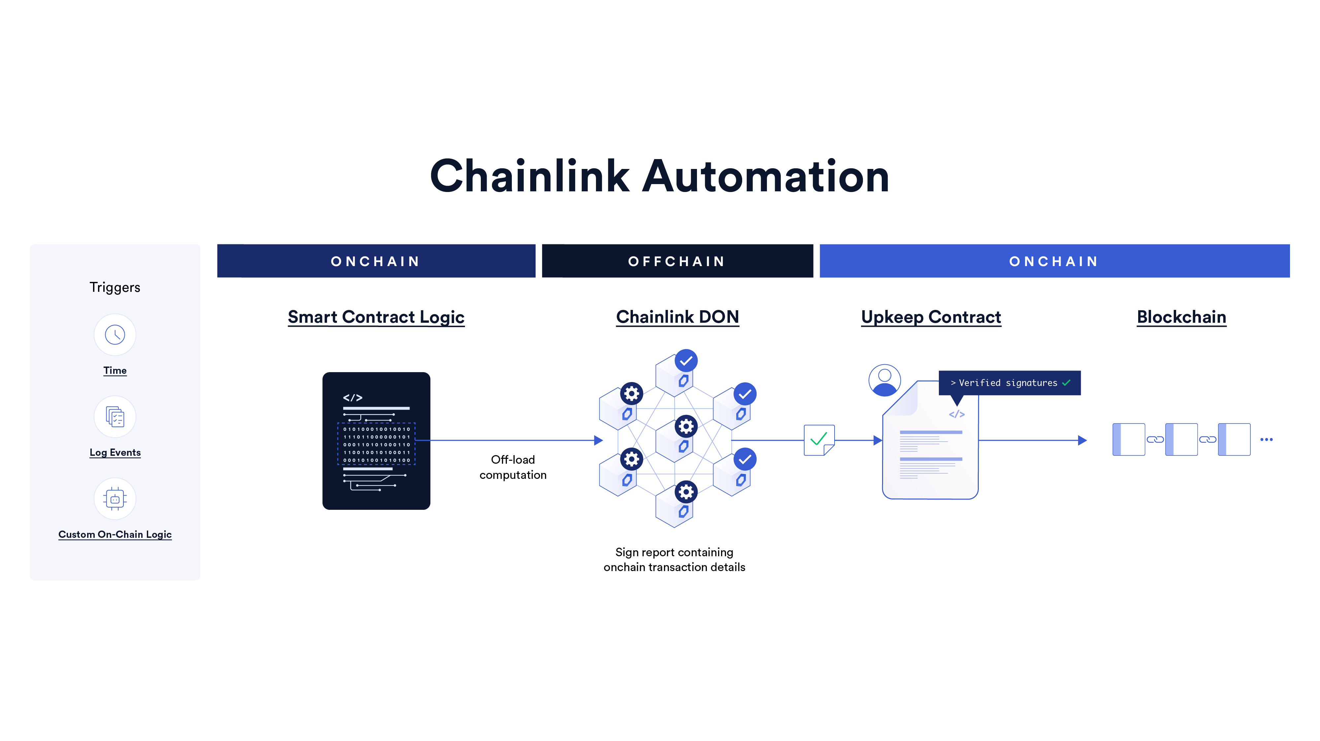
Lecture
SLIDE 9 / 14
Smart Contracts in Conservation
EXAMPLE
Payment released only when satellite data confirms reforestation success.
• Smart contracts are self-executing code with terms written directly into code.
• They automatically release funds when environmental targets are verified on-chain.
• Reduces administrative overhead and eliminates human bias in fund distribution.
• Ensures funds are used strictly for intended ecological conservation purposes.
Source: cdn.prod.website-files.com
Chandigarh University
9 / 14
Notes:
Smart contracts are like digital vending machines for conservation funding. They automatically release money when specific conditions are met. For instance, a donor might set a rule that funds are released only when satellite data confirms trees have been planted. This removes human bias and ensures money goes exactly where it is needed.

Slide 10
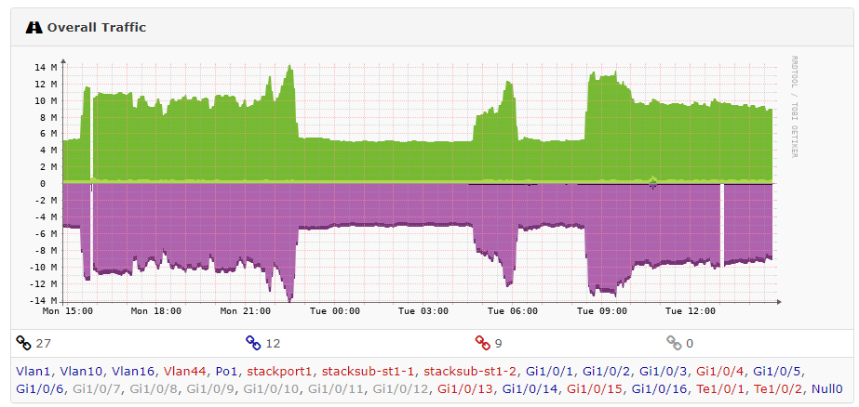
Common Pitfall
SLIDE 10 / 14
Scalability Issues
SOLUTION
Use Layer 2 scaling solutions or private blockchains for high frequency.
• Public blockchains may have slow transaction speeds during high network traffic.
• Large volumes of sensor data can overwhelm the network capacity limits.
• Latency can delay critical alerts for immediate ecological threats or disasters.
• Storage costs increase significantly if all raw data is stored on-chain.
Source: community.librenms.org
Chandigarh University
10 / 14
Notes:
One major pitfall is scalability. Public blockchains can get slow when many transactions happen at once. If you have thousands of sensors sending data, the network might lag. This delay could be critical if you are trying to stop an illegal activity in real-time. We must choose the right type of blockchain or use scaling solutions to handle the load.

Slide 11
Common Pitfall
SLIDE 11 / 14
Data Privacy
SOLUTION
Use zero-knowledge proofs to verify data without revealing details.
• Public ledgers make all data visible to anyone, which may violate privacy.
• Sensitive locations of endangered species should not be fully public.
• Stakeholders may hesitate to share data if competitors can see their metrics.
• Regulatory compliance requires careful handling of personal or sensitive data.
Chandigarh University
11 / 14
Notes:
Another pitfall is privacy. If we put everything on a public blockchain, anyone can see the data. This is dangerous for endangered species locations, as poachers could use it. We must use techniques like zero-knowledge proofs to verify the data without revealing the sensitive details. This balances transparency with the need for secrecy.

Slide 12
Common Pitfall
SLIDE 12 / 14
Integration Complexity
1
Legacy systems often lack the APIs needed to connect with blockchain networks.
2
Integrating IoT sensors with blockchain requires significant technical expertise.
3
High initial setup costs can deter small conservation organizations from adoption.
4
Standardization of data formats is often missing across different organizations.
5
Training staff to use new blockchain tools takes time and resources.
Chandigarh University
12 / 14
Notes:
Integration is often harder than expected. Many existing systems are old and cannot easily talk to blockchain networks. Connecting IoT sensors requires specialized skills that might not be available in smaller teams. The initial cost and training required can be a barrier for smaller conservation groups. We must plan for these integration challenges carefully.

Slide 13
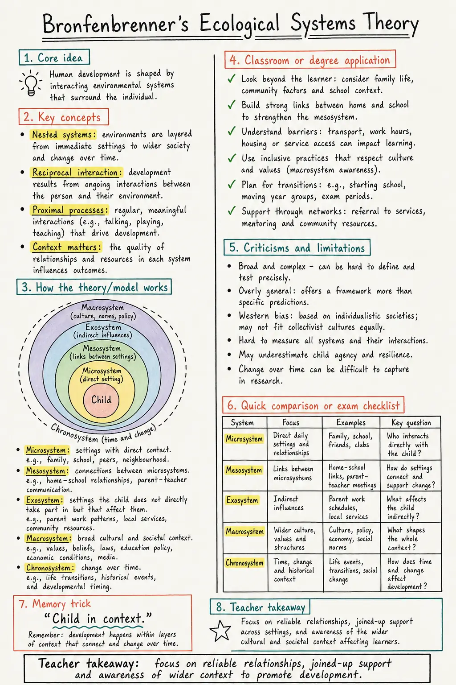
Lecture
SLIDE 13 / 14
Key Takeaways
1
Blockchain provides immutable, transparent records essential for ecological data trust.
2
Smart contracts automate compliance and fund distribution based on verified data.
3
Efficiency gains can reduce verification time by over 90% in case studies.
4
Scalability and privacy must be addressed to prevent implementation failures.
5
Data integrity is critical for analyzing trends and predicting ecosystem impacts.
Source: cdn.prod.website-files.com
Chandigarh University
13 / 14
Notes:
To summarize, blockchain creates a trustworthy foundation for ecological data through immutability. It automates processes and saves significant time and money. However, we must be careful about scalability and privacy issues. Ultimately, this technology empowers us to analyze data more effectively and predict future impacts on our ecosystems.

Slide 14
Lecture
SLIDE 14 / 14
References
ENVIRONMENTAL STUDIES
From Crisis to Cure — R. Rajagopalan
• Environmental Science and Engineering — Benny Joseph
• Environmental Studies — R.C. Sharma and D. Gurbir Sangha
• Introduction to Environmental Science — Anjaneyulu, Y.
• Environmental Pollution Control Engineering — C.S. Rao
• Textbook of Environmental Studies for undergraduate courses — E. Bharucha
• Environmental Science — S.C. Santra
Chandigarh University
14 / 14
Notes:
These are the reference books you should consult for further reading on environmental science and engineering. They provide the foundational knowledge required to understand the ecological context of these security applications. Please review these texts to deepen your understanding of the subject matter. Thank you for your attention.

